Slide 1
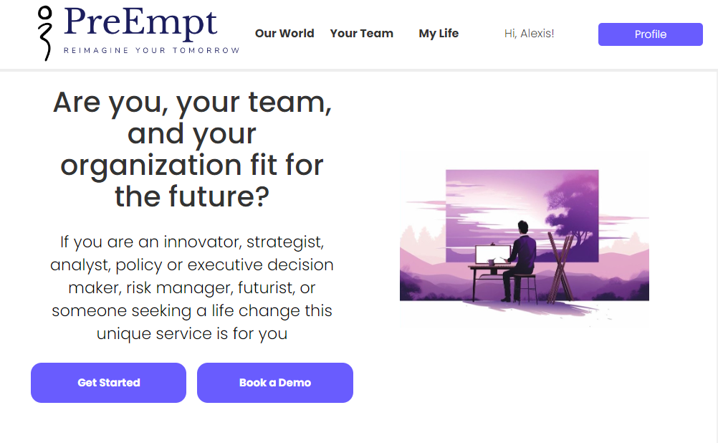
Rapidly audit your organization,
your challenges, or your life, and
repaint your future

Slide 2
Introduction
Welcome to PreEmpt
Advanced Forward Decision Intelligence (DI) Platform
Our mission:
"Reimagine Tomorrow"

Slide 3
The Challenge
Global challenges require robust analytical tools
Risk of escalating uncertainty and complexity
Need for better questioning critical thinking and imagination

Slide 4
Our Solution
Integrated foresight, strategy, design, systems, and critical thinking
Non-linear, holistic approach
Rapidly generate strategies, scenarios, and actionable answers

Slide 5
Unique Selling Points
PREEMPT
LINEAR (OTHERS)
Pattern-based
High decision HI/AI intelligence*
In-context
Holistic answers/outcomes
Answers in hours at ultra low cost
Forecast-based
Limited understanding and wisdom
Out-of-context
More questions/outputs
Answers in months at high cost!

Slide 6
Whose it for?
Change agents, Innovators, Strategists
Risk Managers, Problem solvers,
Designers, Critical Thinkers, Venturers
Foresighters, Researchers, Imagineers
Intelligence Analysts, Policy makers
Decision makers seeking to reimagine their organizations and their lives

Slide 7
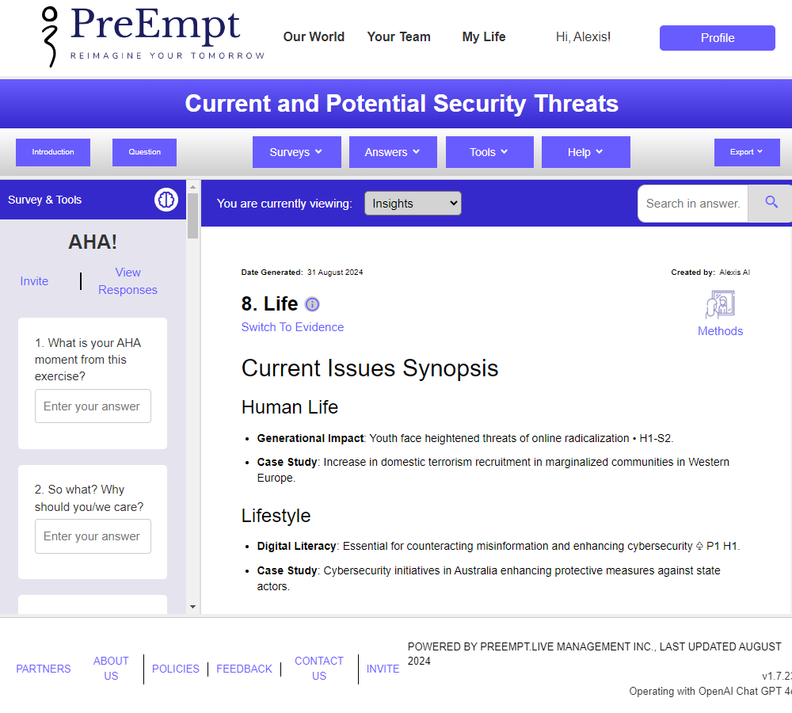
Our Purpose
Democratize collective futures thinking
Unite global consciousness and digital foresight literacy
Engage stakeholders in collaborative problem solving
Offer low-cost, near-real-time foresight to all

Slide 8
Value Proposition
Strategic Decision-Making
Innovation and Competitive Advantage
Ethical and Sustainable Practices
Talent Development and Retention
Collaborative Ecosystem
Risk Mitigation and Compliance

Slide 9
The Preempt System
650+ integrated foresight, strategy, design, system, and critical thinking methods
Thousands of embedded, vital. and future-oriented questions
Holistic, practical, inspiring, and engaging solutions

Slide 10
Services
Standard Outputs
Strategy
Reasoning
Insights
Evidence
Personal Futures
Private Challenges
…
To Order/coming soon
Competitive Intelligence
Scientific Discovery
Speculative Design
Possible futures
Product development
Problem solving
...

Slide 11
Use Cases
Evaluate organizations, sectors, and prospects
Track emerging technologies and issues
Generate alternative futures and strategies
Conduct sensitivity analysis and simulations
Set up monitoring, audit and evaluation systems

Slide 12
Pricing
Syntheses: $190 each
Custom private sites: $11,990 per annum
Significant cost savings compared to traditional methods

Slide 13
Our Beliefs
Power of prescience
Integration of AI and human ingenuity
Empowering you to cut through uncertainty
Enabling everyone to own their destinies

Slide 14
Ethics and SustainabililitY
Principles
At PreEmpt, we are determined to deliver human-centric AI solutions underpinned by:
Explainable and Self-auditing AI that turns a black box into a near white box.
Generic instructions designed to be respectful of human rights, including Safe, Sustainable, and FairAI.
Fully focusing on AI for universal human good.
Controllable AI only by humans.

Slide 15
Contact US
Email: mike@preempt.life
Website: www.preempt.life
Let's reimagine your tomorrow together!

